Slide 1
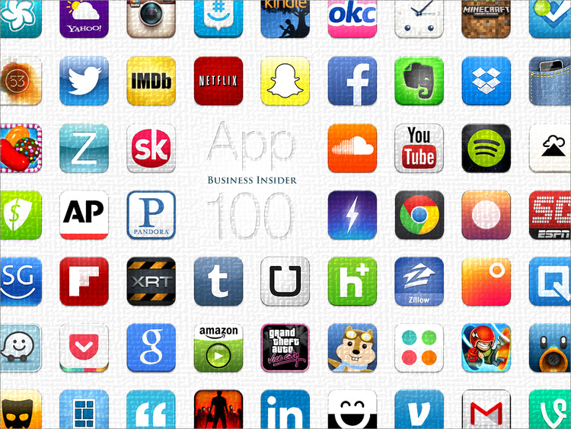
Mobile App Development
Phoebe Wu

Slide 2
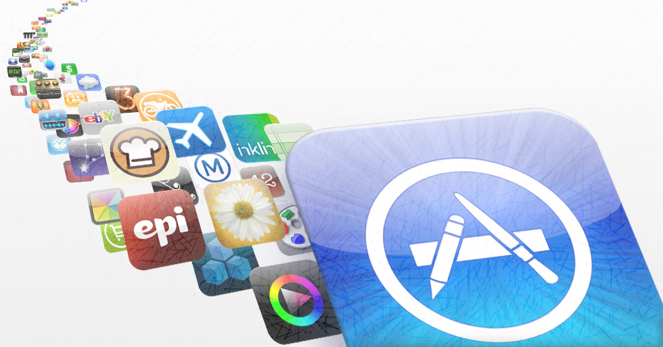
Research Background & Question
The number of smartphone user are almost 3 billion around the world in 2018. → the importance of the smartphone App nowadays
What can make an app become a top trending (top installation/downloads) app in the app store?
How to make an App get high rating (rating >= 4.0) from users?
Google Android(26.8%) and Apple iOS(24%) are the two most popular smartphone operating systems in the smartphone industry.
→ Google Android App & Apple iOS App

Slide 3
Datasets - from Kaggle
Dataset 1 : Google Play App Store
- The data was scraped from Google Play Store.
- This dataset contains more than 10 thousands app information and 37 thousands app reviews.
Dataset 2 : Apple iOS Apps
- The data was extracted from the iTunes Search API at the Apple Inc website.
This dataset contains about 7200 Apple IOS mobile application details and descriptions.

Slide 4
The Google App
App information dataset
1. App: App name
2. Category: Category the app belongs to
3. Rating: Overall user rating of the app
4. Reviews: Number of reviews
5. Size: Size of the app
6. Price
7. Type: Free or Paid
8. Installs: Number of user downloads/installs the app
9. Content Rating: the target age group of the app (children/ mature 21+/ adult)
App reviews dataset
1. App: App name
2. Translated review: User review
3. Sentiment: Positive/Negative/Neutral

Slide 5
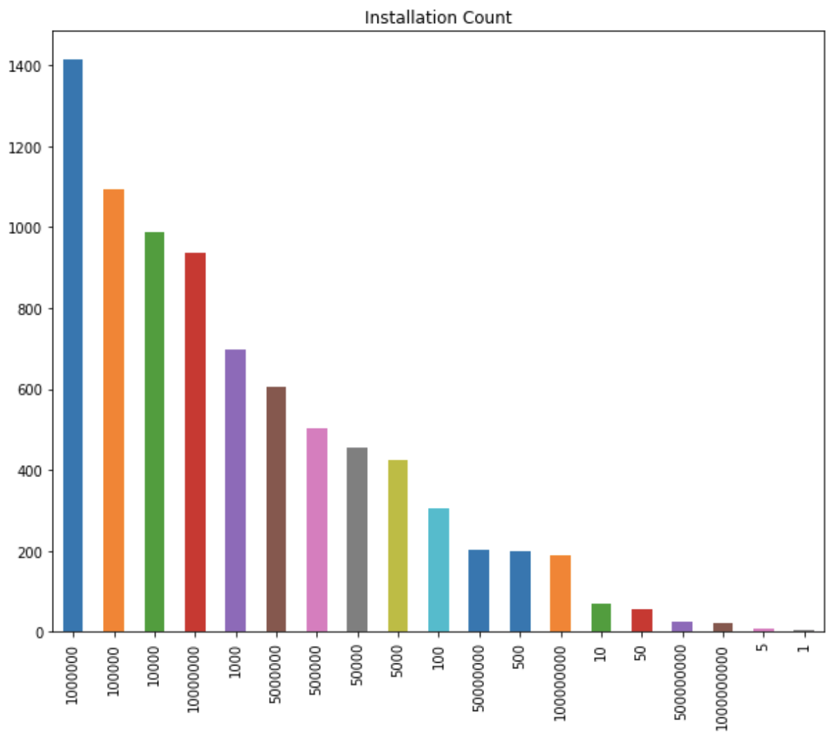
EDA
Google Android App
→ In order to classify the rating, I change the rating into 1.5, 2.5, 3.5, 4.5 & 5.0

Slide 6
The Apple App
App information dataset
1. App Name
2. size_bytes: Size (in Bytes)
3. price
4. prime_genre
5. rating_count_tot: User Rating counts (for all version)
6. rating_count_cur: User Rating counts (for current version)
7. user_rating: Average User Rating value (for all version)
8. user_rating_cur: Average User Rating value (for current version)
9. cont_rating: Content Rating( 4+: all age, 9+: age over 9, 12+: age over 12, 17+: age over 17)
10. sup_devices_num: Number of supporting devices
11. screenshot_num: Number of screenshots showed for display
12. lang_num: Number of supported languages
App description dataset
1. App Name
2. app_desc: Application description

Slide 7
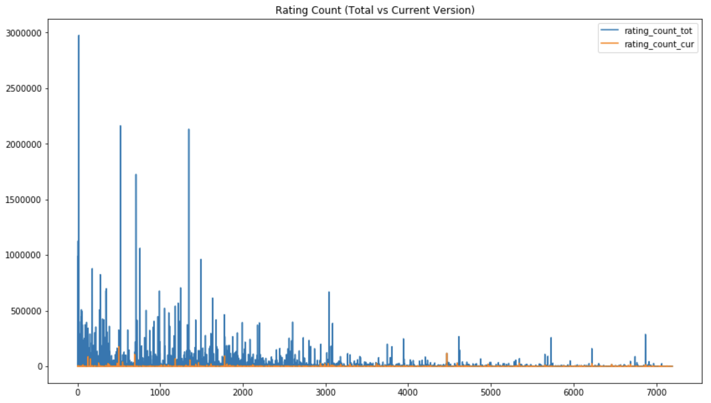
EDA
Apple iOS App

Slide 8
Challenge & Adjustment
Firstly, I try to classify the rating which are classes 1.0, 1.5, 2.0, …, 4.5, 5.0. → The accuracy was around 0.3
I tried cross validation, PCA but the results did not improve.
Finally, I redefined the classes into rating >= 4.0 & < 4.0
Moreover, in Apple app dataset, I create a new column:
‘rating count before’
(‘total rating count’ – ‘current version rating count’)

Slide 9
Analysis
Classification & Regression - App information (Apple App & Google Store App)
- Rating >= 4.0 vs < 4.0
Installation count & Rating count
Classifying the Positive, Neutral and Negative reviews
Natural Language Processing → developers‘ emphasis match users‘ concern
1. Google Store App reviews
Find the most frequent words in the reviews
2. Apple App description
Find the most frequent words in the descriptions

Slide 10
User Rating - Google App
Classification
Random Forest, KNN, Logistic Regression, Decision Tree
Features (feature importance)
'Size', 'Category', 'Price’
Train-test-split: 70/30

Slide 11
User Rating - Apple App
Classification
- Random Forest, KNN, Logistic Regression, Decision Tree
Features(feature importance)
'size', 'rating count before', 'language number', 'prime genre' and 'support devices number’
Train-test-split: 70/30

Slide 12
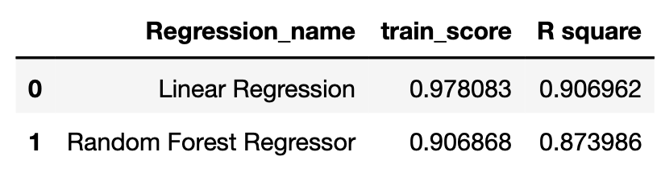
User rating count (Installation) - Apple App
Regression
Features
‘size’, 'rating count before’, 'content rating', 'support devices number' , 'language number’
Train-test-split: 70/30

Slide 13
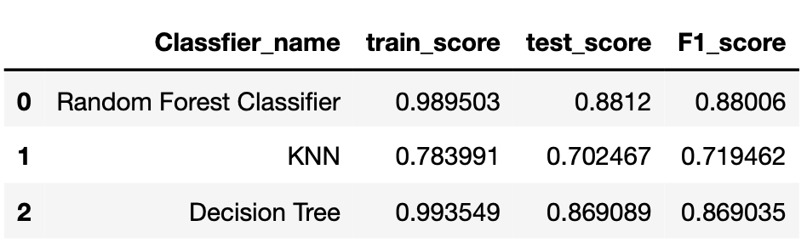
Google APP Reviews
NLP & Classification – Positive, Neutral and Negative
Random Forest Classifier
KNN
Decision Tree
Train-test-split: 70/30

Slide 14
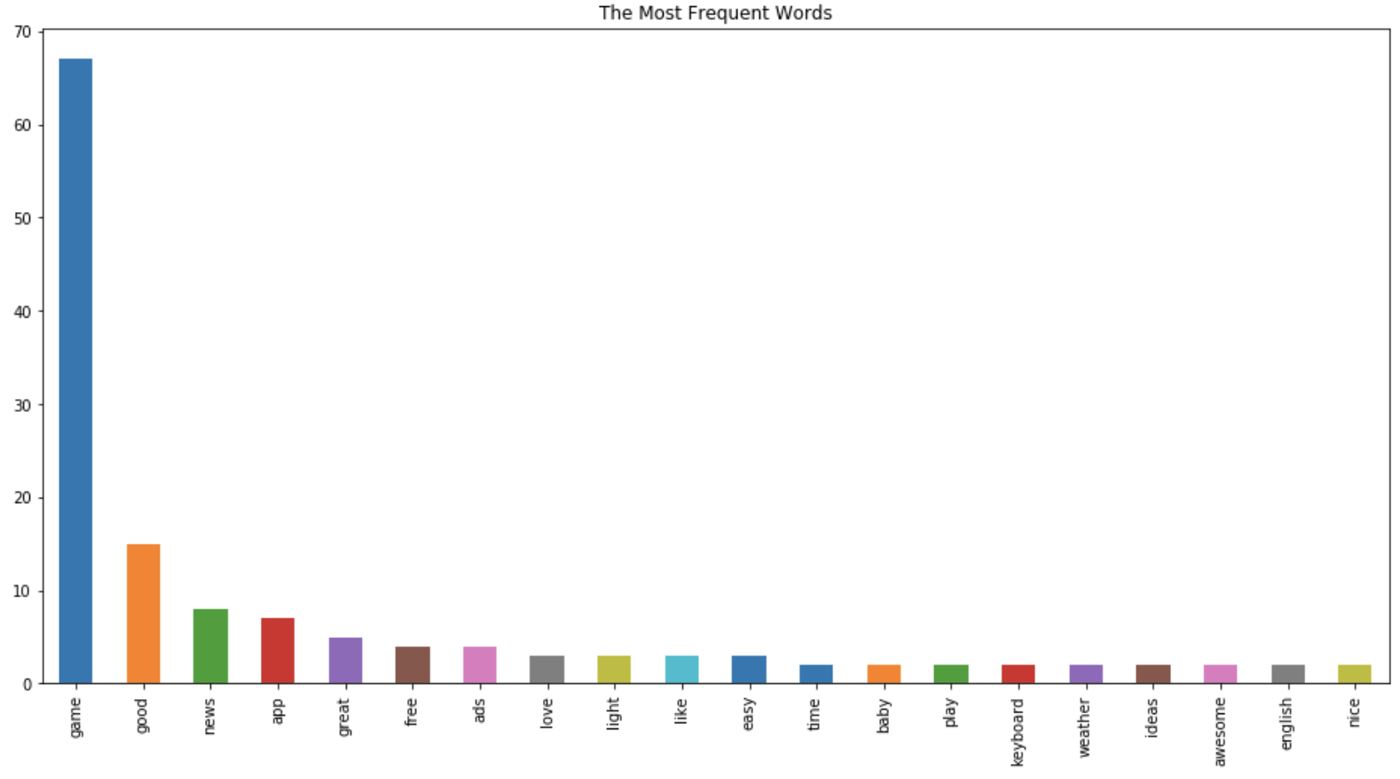
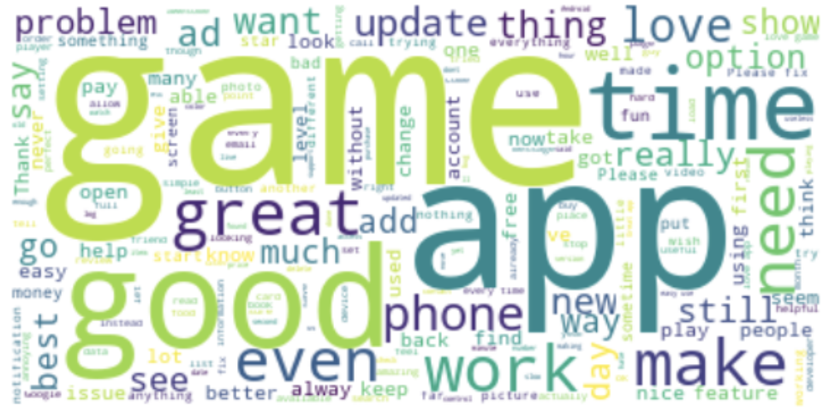
NLP – Google APP Reviews
The most frequent words
Game
News
Weather
Good
Free
Ads
Light
Easy
Time

Slide 15
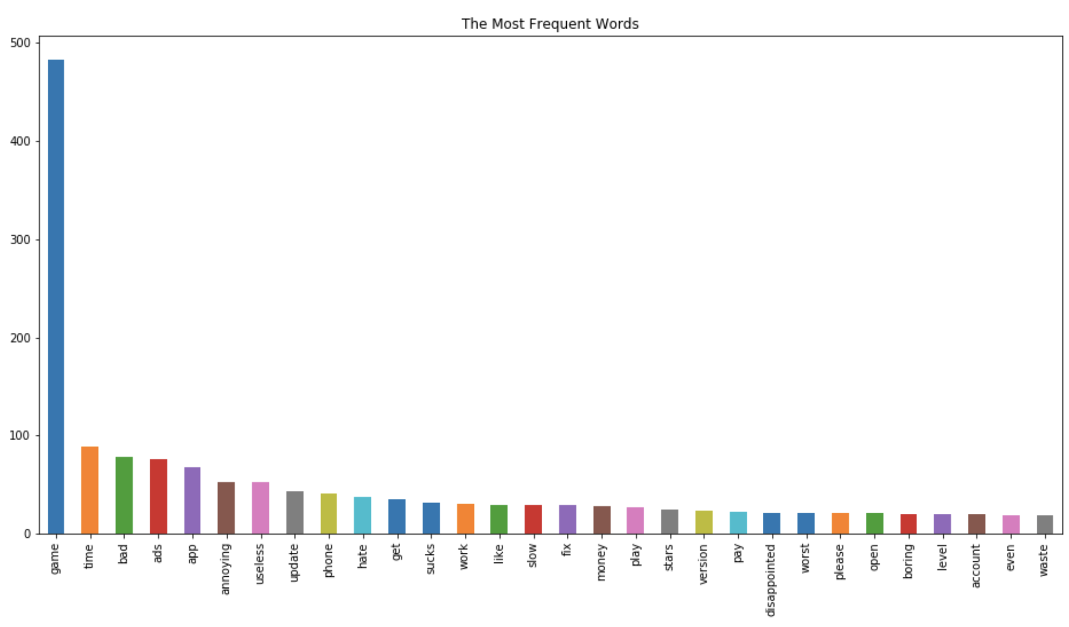
NLP – Google APP Negative Reviews
The most frequent words – except the emotional words
Time
Ads
Useless
Slow
Money
Pay
Waste

Slide 16
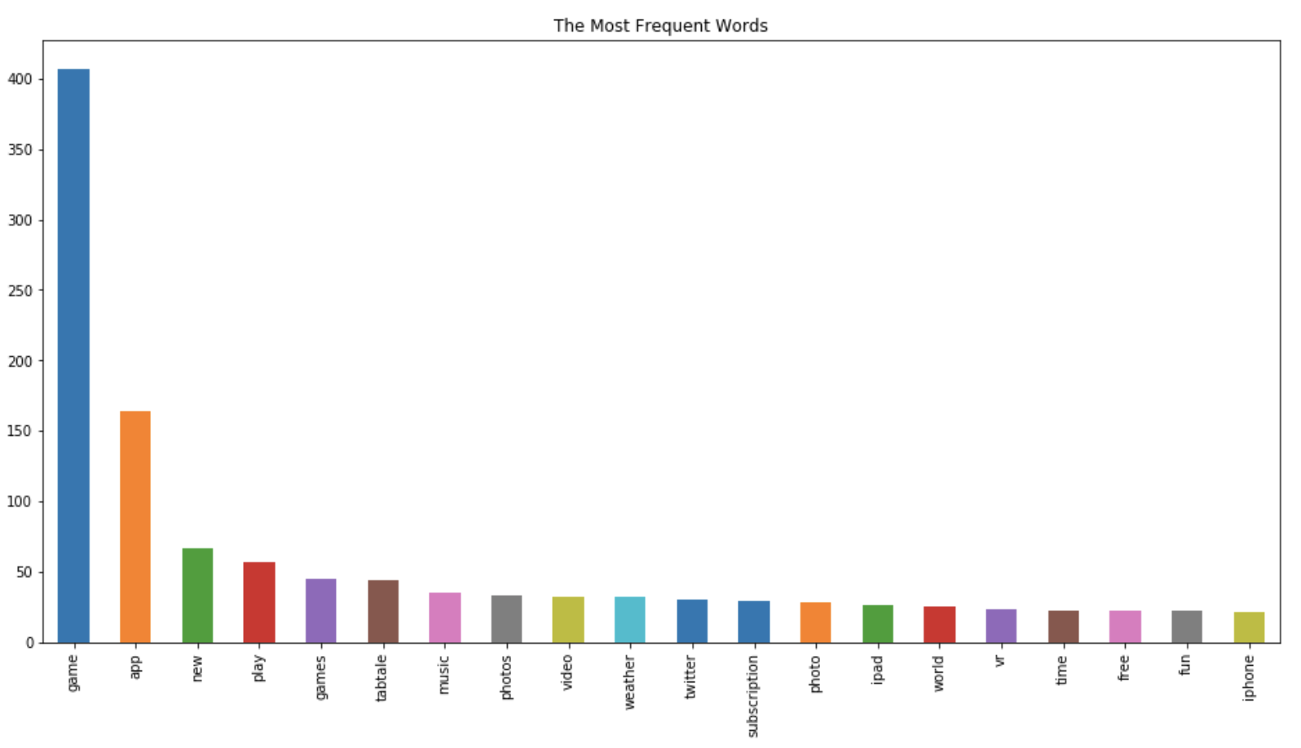
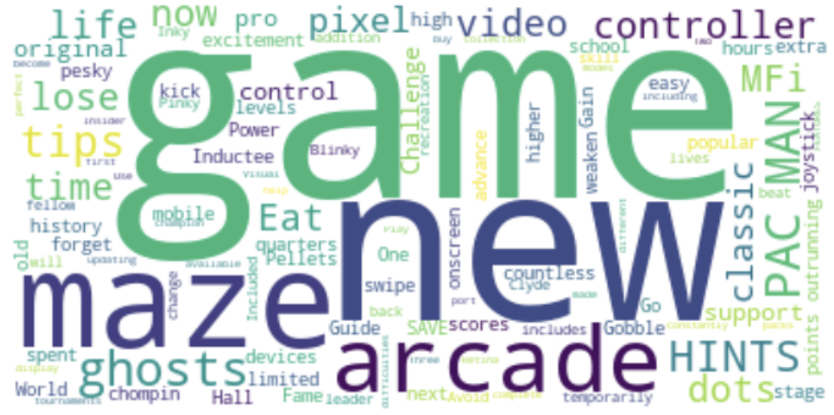
NLP – Apple App Descriptions
The most frequent words –
Game
Music
Photo
Video
Weather
New
Play
Time
Free

Slide 17

NLP – Apple High Rating App Description
The most frequent words –
Game
New
Play
Music
Photo
Video
Weather
Subscription
Fun
Privacy
Time

Slide 18
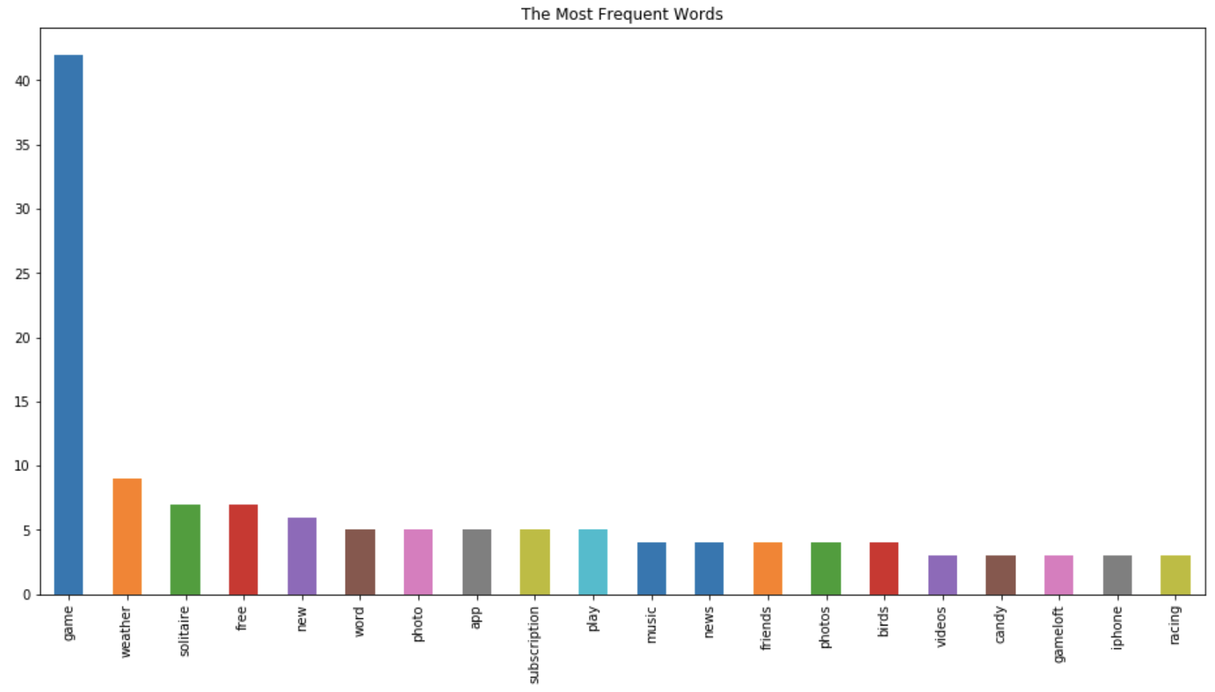
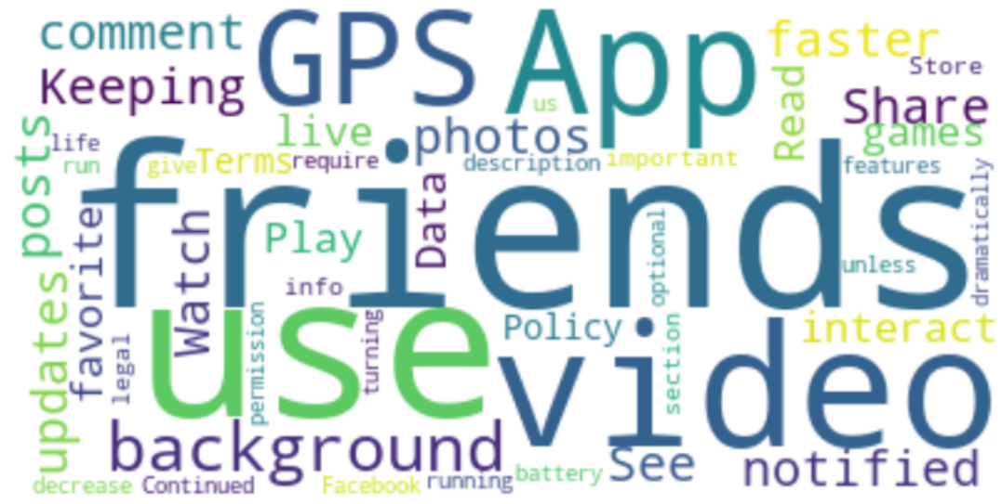
NLP – Top Trending App Descriptions
The most frequent words –
Game
Weather
Free
Photo
Subscription
Music
News
Friends
Videos
Share

Slide 19
Conclusion
Getting High Rating
- Google Android App – Size, Category and Price
Apple iOS App – Size, Prime genre, number of Supporting Devices and Language
Become Top Trending – Size, Content rating, number of Supporting Devices and Language
Most Frequent words in both reviews & descriptions – Game, Time and Free
Game → The most popular app category in both system
Time & Free→ The concern by both developers and users
Reviews: Useless & Ads → Useful or not and ads disturbance
Descriptions: Friends and share → related to the top trending Social media apps

Slide 20
Conclusion - Apply to Real World
For both Operating System:
- Size, Price, Number of Supporting Devices and Languages for developing High Rating & Top Trending Apps
Google Android App
- Improving the app operating speed and make the app easier to use
Apple iOS App
- Put more focus on the number of supporting devices and language of the app.

Slide 21
Thank You

